Slide 1
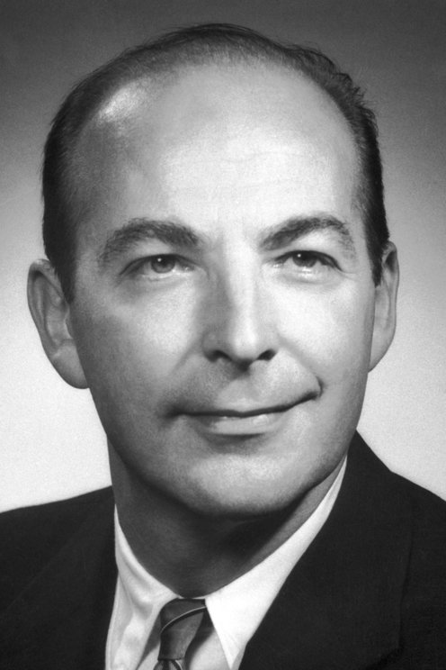
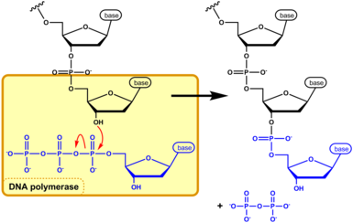
Lecture - 10
Arthur Kornberg
5’
3’

Slide 2
If synthesis always proceeds in the 5’ to 3’ direction, how can both strands be synthesized simultaneously? If both strands were synthesized continuously while the replication fork moved, one strand would have to undergo
3’ to 5’ synthesis.
This problem was resolved by Reiji Okazaki and colleagues in the 1960s. Okazaki found that one of the new DNA strands is synthesized in short pieces, now called Okazaki fragments.

Slide 3
PNAS February 1, 1968 59 (2) 598-605
Semi-discontinuous replication

Slide 4
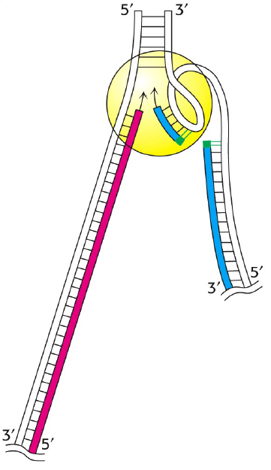
Coordinated replication of
leading and lagging strands
Notes:
The antiparallel nature of DNA creates a complication for the simultaneous replication of the two exposed templates at the replication fork. Because
DNA is synthesized only by elongating a 30 end, only one of the two exposed
templates can be replicated continuously as the replication fork moves. On
this template strand, the polymerase simply “chases” the moving replication
fork. The newly synthesized DNA strand directed by this template is
known as the leading strand.
Synthesis of the newDNA strand directed by the other ssDNA template is
more complicated. This template directs theDNApolymerase tomove in the
opposite direction of the replication fork. The new DNA strand directed by
this template is known as the lagging strand. As shown in Figure 9-12, this
strand of DNA must be synthesized in a discontinuous fashion.
Although the leading-strand DNA polymerase can replicate its template
as soon as it is exposed, synthesis of the lagging strand must wait for movement
of the replication fork to expose a substantial length of template before
it can be replicated. Each time a substantial length of new lagging-strand
template is exposed, DNA synthesis is initiated and continues until it
reaches the 50 end of the previous newly synthesized stretch of laggingstrand
DNA.
The resulting short fragments of new DNA formed on the lagging strand
are called Okazaki fragments and vary in length from 1000 to 2000 nucleotides
in bacteria and from 100 to 400 nucleotides in eukaryotes. Shortly after
being synthesized, Okazaki fragments are covalently joined together to generate
a continuous, intact strand of new DNA (see later discussion). Okazaki
fragments are therefore transient intermediates in DNA replication.

Slide 5
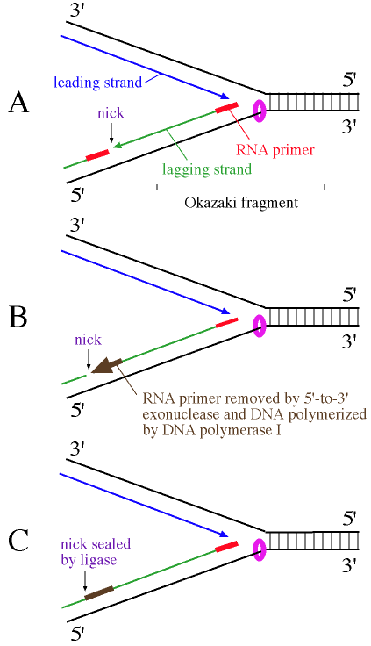
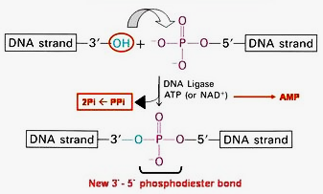
Joining of Okazaki fragments

Slide 6
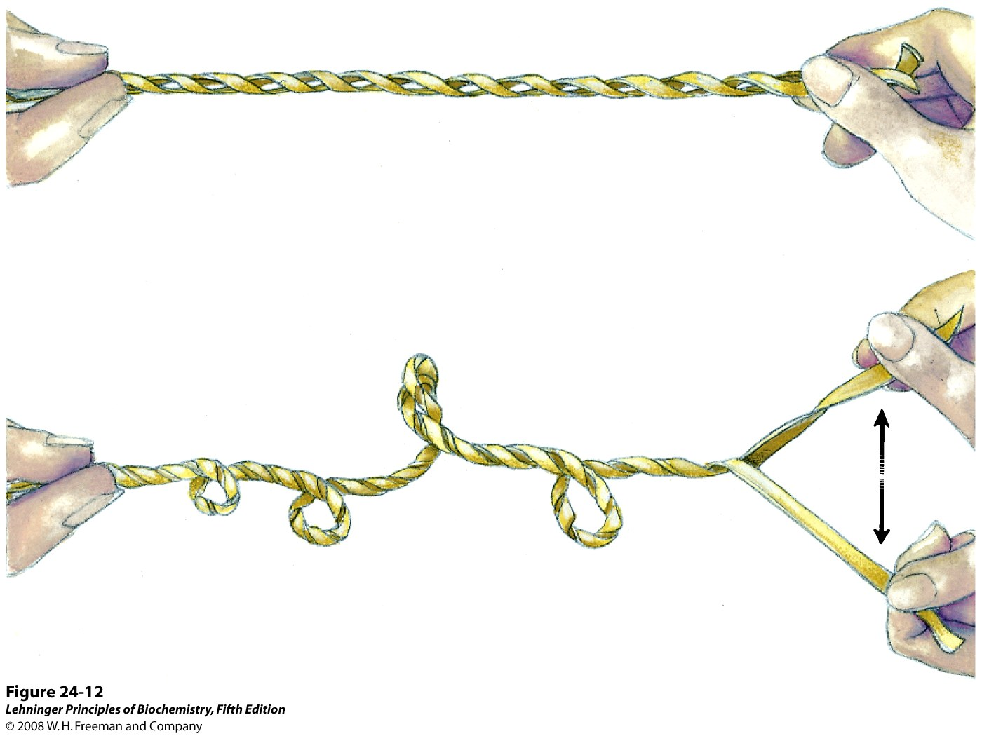
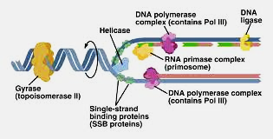
Helicase
Replisome
Notes:
Helicase-DNA polymerase interaction is critical to initiate leading-strand DNA synthesis
Huidong Zhang, Seung-Joo Lee, Bin Zhu, Ngoc Q. Tran, Stanley Tabor, and Charles C. Richardson
PNAS June 7, 2011 108 (23) 9372-9377; https://doi.org/10.1073/pnas.1106678108

Slide 7
DNA replication is very accurate
Do not allow incorrect base pairs
Do not allow rNTPs

Slide 8
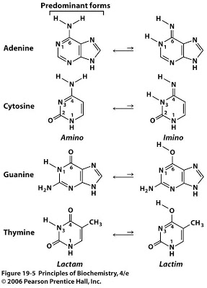
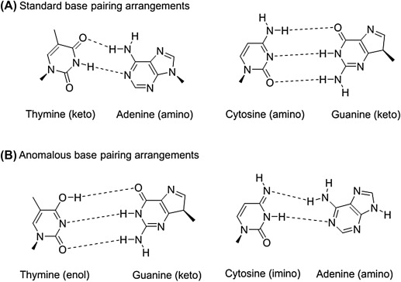
Tautomerism and incorrect base pairing
Tautomers are structural isomers of chemical compounds that readily interconvert. This reaction commonly results in the relocation of a proton.
This can lead to error in DNA replication

Slide 9
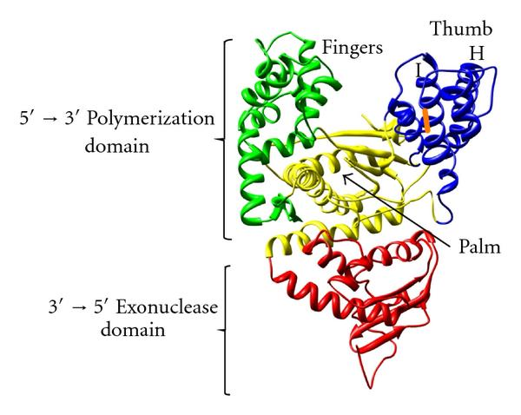
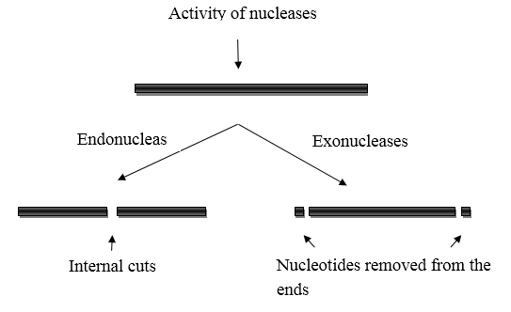
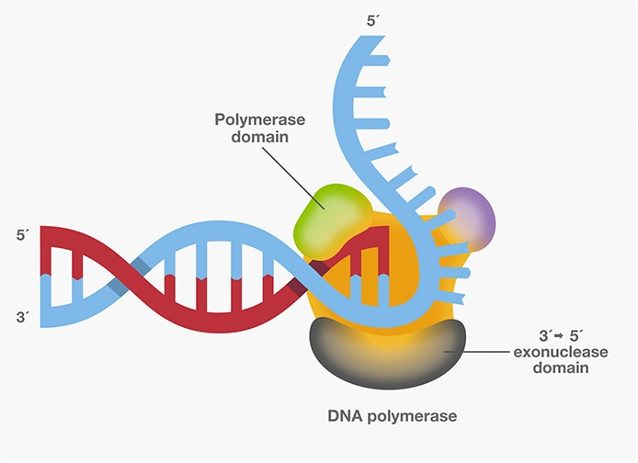
Proof reading activity of DNA Polymerase
The error rate during DNA replication is as low as 10⁻⁹ to 10⁻¹¹ errors per base pair

Slide 10
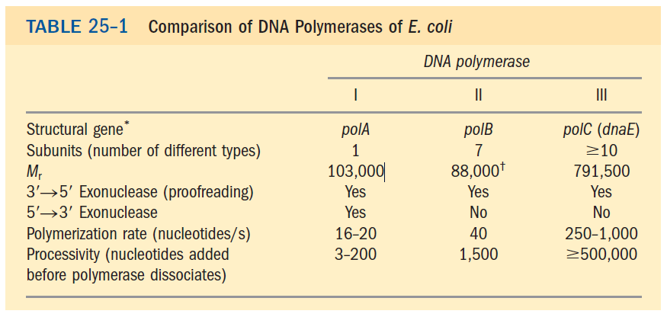
DNA Polymerases are processive enzymes
Processivity is an enzyme's ability to catalyze consecutive reactions without releasing its substrate
Catalysis by DNA polymerase is rapid. DNA polymerases are capable of adding as many as 1000 nucleotides/sec to a primer strand.
The speed of DNA synthesis is largely due to the processive nature of DNA polymerase.

